Slide 1
The Hunt

Slide 2


Team Members
Yeshwanth Damera Pruthvi Naskanti

Slide 3
Overview
We would like to create an app that can be played on a mobile device. The app would encourage players to complete a 'quest' by encountering a specific list of locations.
A player would activate one of the locations in the quest. To score that location, the user must enter the geographic area. Full CRUD for locations will be implemented.

Slide 4
Tech Stack
Framework - Spring Boot
Database - My SQL
Tools - Eclipse/SpringToolSuite, MySQL Workbench
Platform - Web Application

Slide 5
Repo and Heroku Link
Repo URL: https://github.com/pruthvi-naskanti/The-Hunt-FSA9
Heroku Link: https://huntappgame.herokuapp.com/

Slide 6
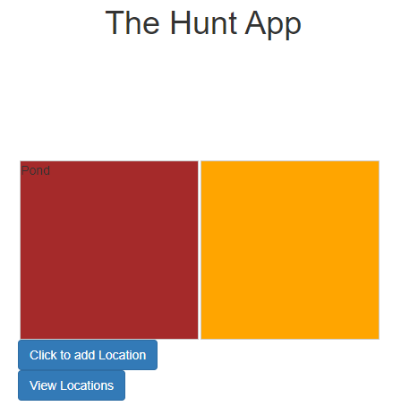
Application overview
There will be two colored boxes in the application, when the user clicks the first color, it would pull out a valid location from database where the quest is already present.

Slide 7
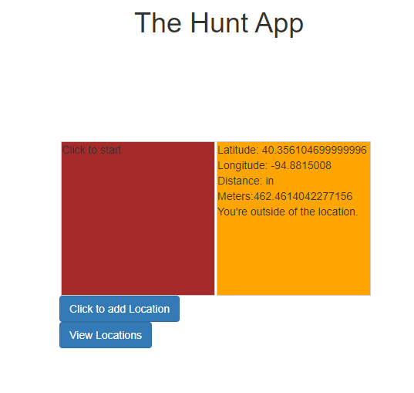
Application overview
When user clicks the second box, it would give users current location with latitude and longitude details.

Slide 8
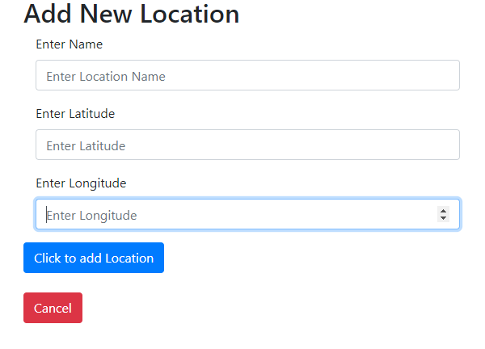
Application overview
A user can drop a location(insert into the database) as one of the quest location clicking on CLICK TO ADD LOCATION button with name, latitude and longitude details for the location.

Slide 9
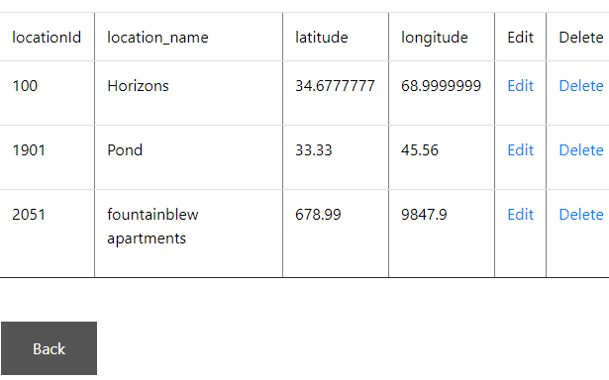
Application overview
VIEW LOCATIONS returns the list of locations added to the database These are the valid quest locations where location details are listed along with location ID.
[NOTE: location_ID for a location will be assigned randomly]

Slide 10
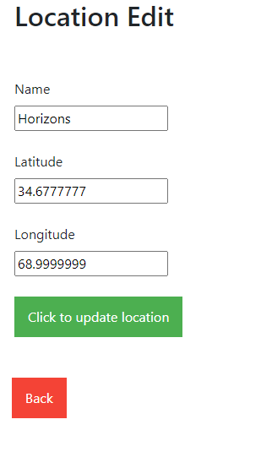
APPLICATION OVERVIEW
A user can edit the location by clicking on edit icon and changing the coordinates and name of the location and click update location button.
To delete the location, click on delete icon from the list of locations.

Slide 11
THANK YOU

